Slide 1
CMSC 471
Artificial Intelligence
Constraints
Many slides courtesy Tim Finin

Slide 2
General Methods of Solving CSPs
Generate-and-Test, aka Brute Force
Search (backtracking)
Consistency checking
  Forward checking
  Arc consistency
  Domain splitting
  Variable Elimination
Localized search

Slide 3
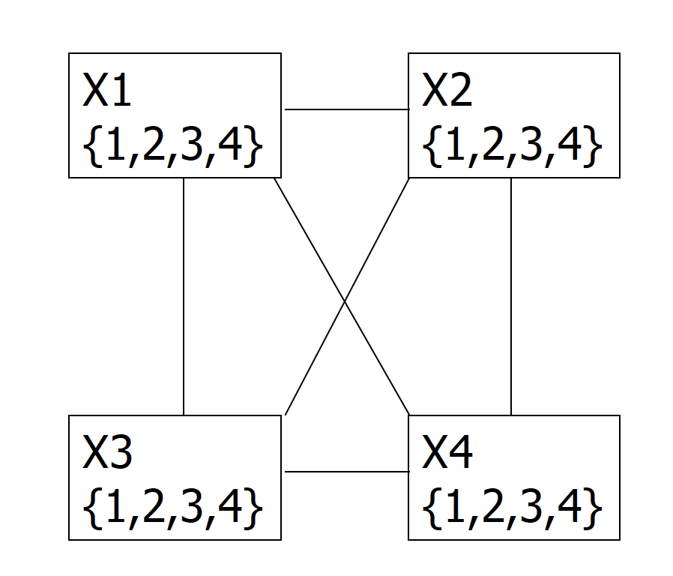
Is AC3 Alone Sufficient?
Consider the four queens problem
1 2 3 4
1
2
3
4

Slide 4
Solving a CSP still requires search
Search:
  can find good solutions, but must examine non-solutions along the way
Constraint Propagation:
  can rule out non-solutions, but this is not the same as finding solutions

Slide 5
Solving a CSP still requires search
Search:
  can find good solutions, but must examine non-solutions along the way
Constraint Propagation:
  can rule out non-solutions, but this is not the same as finding solutions
Interweave constraint propagation & search:
  perform constraint propagation at each search step

Slide 6
1 2 3 4
1
2
3
4
1 2 3 4
1 2 3 4
1 2 3 4
1
2
3
4
1
2
3
4
1
2
3
4

Slide 7
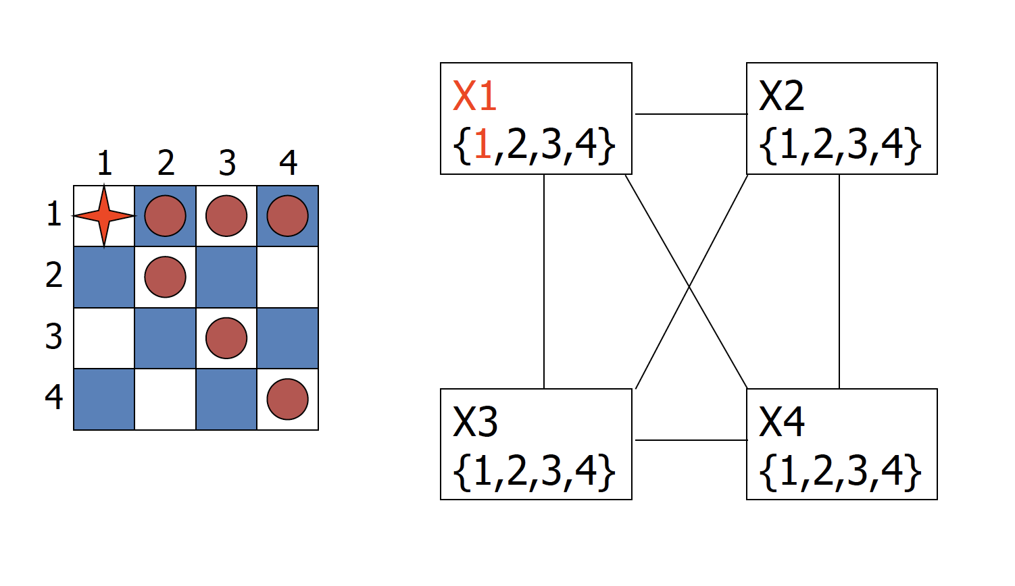
4-Queens Problem

Slide 8
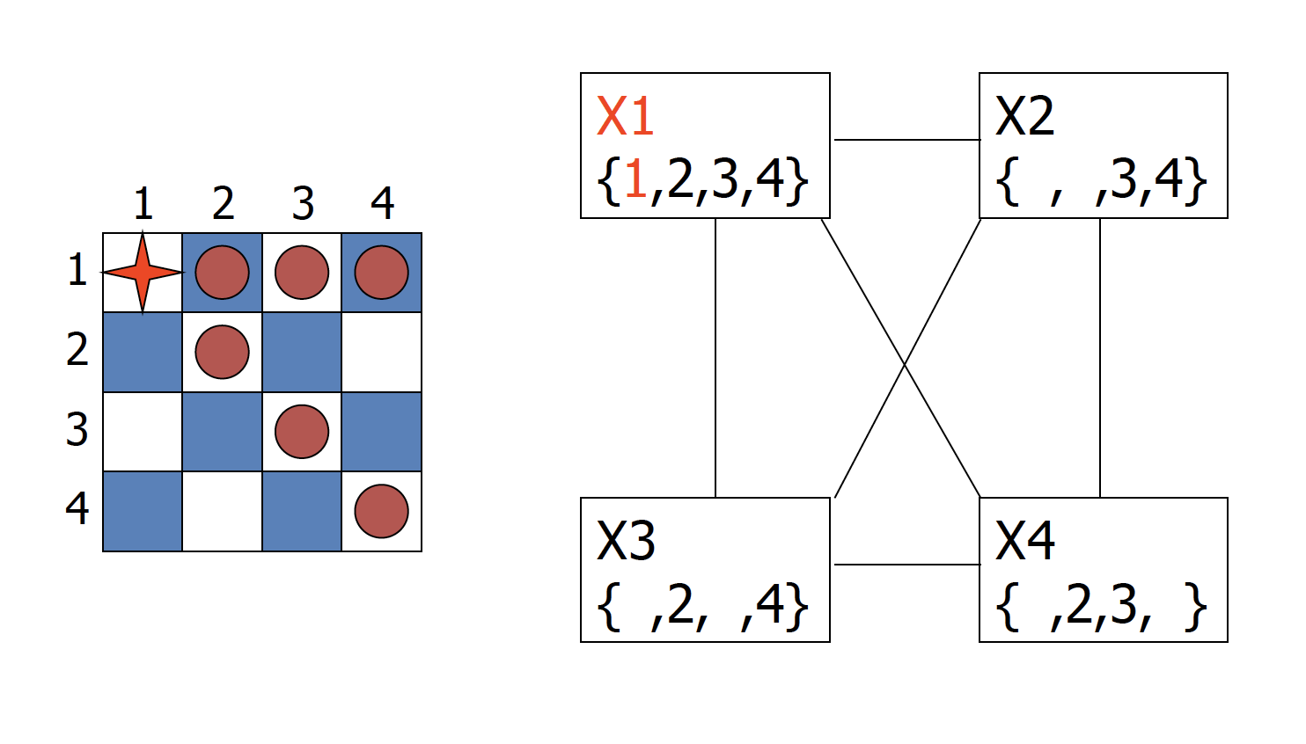
4-Queens Problem

Slide 9
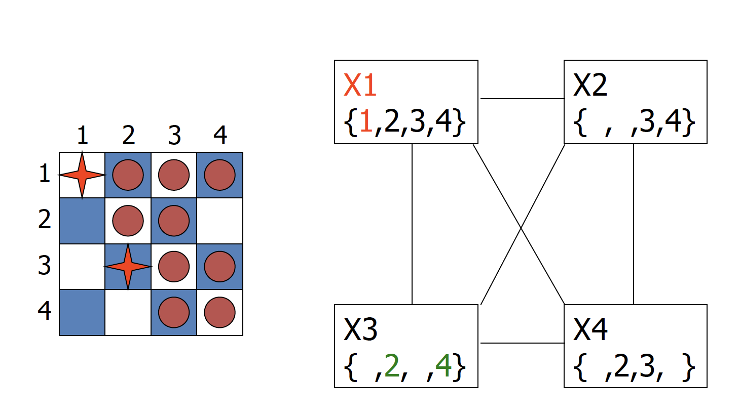
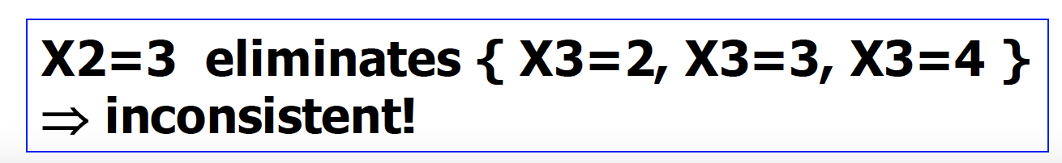
4-Queens Problem

Slide 10
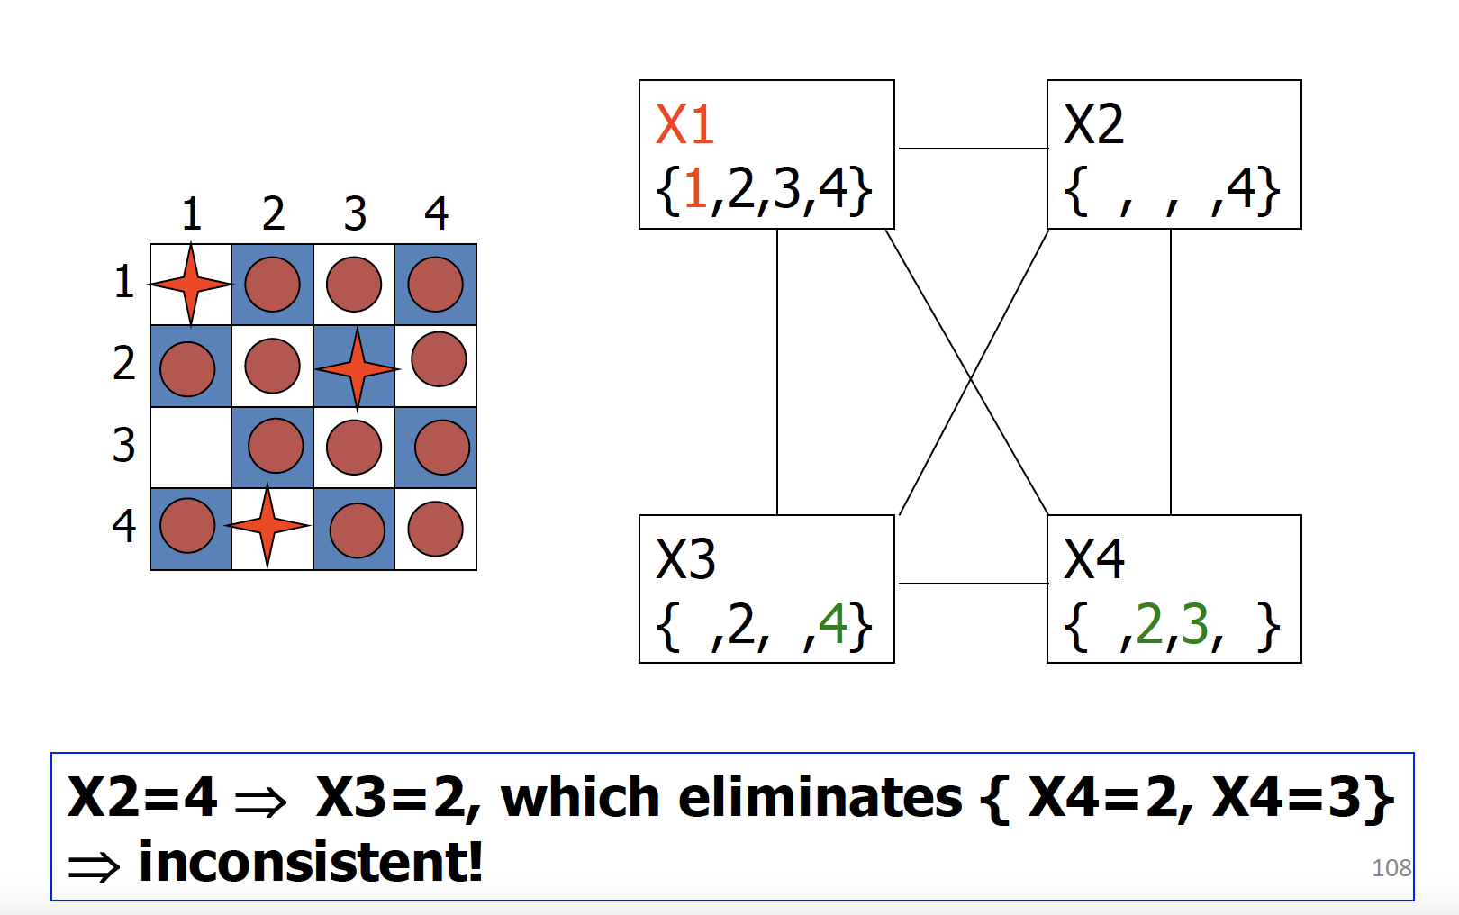
4-Queens Problem

Slide 11
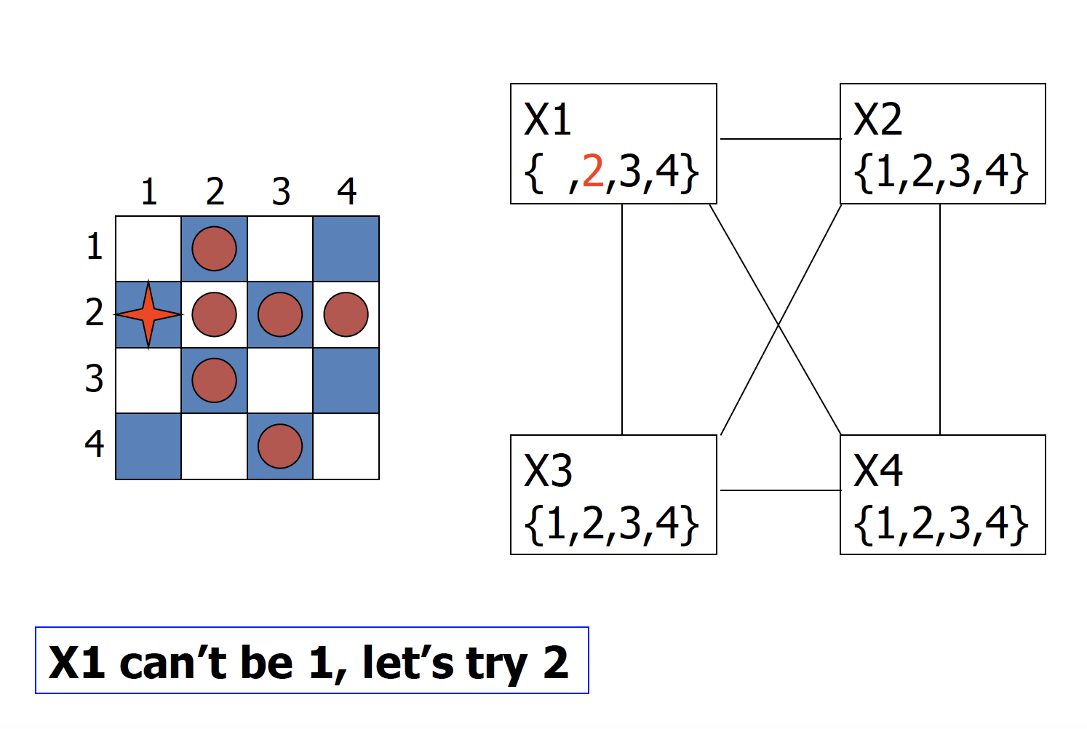
4-Queens Problem

Slide 12
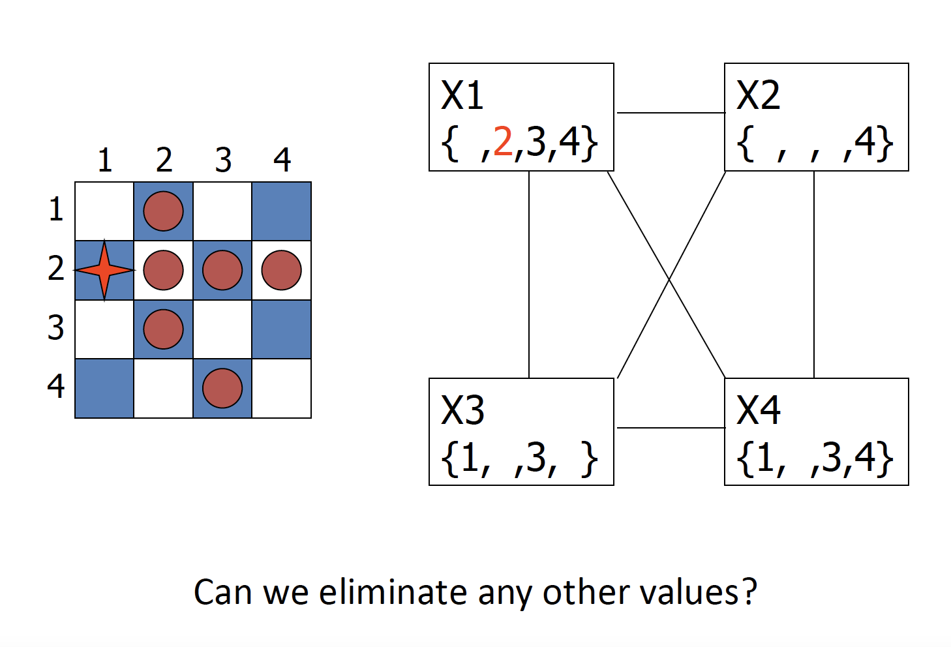
4-Queens Problem

Slide 13
4-Queens Problem

Slide 14
4-Queens Problem

Slide 15
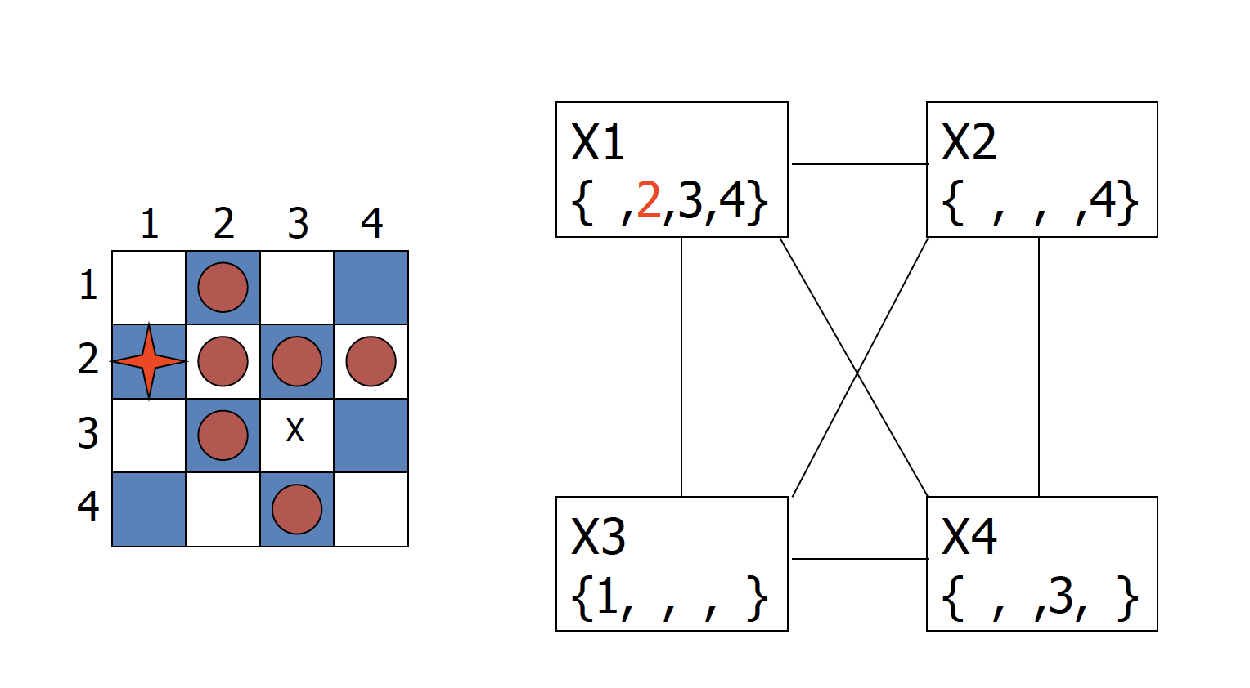
4-Queens Problem

Slide 16
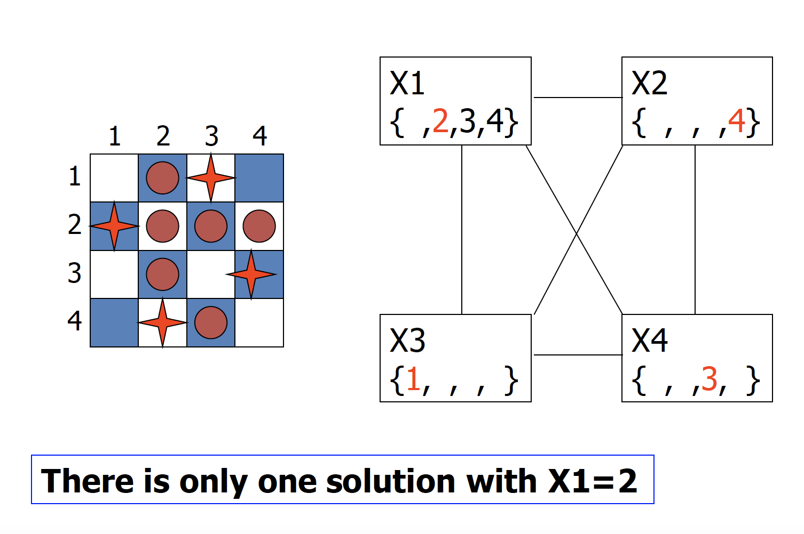
4-Queens Problem

Slide 17
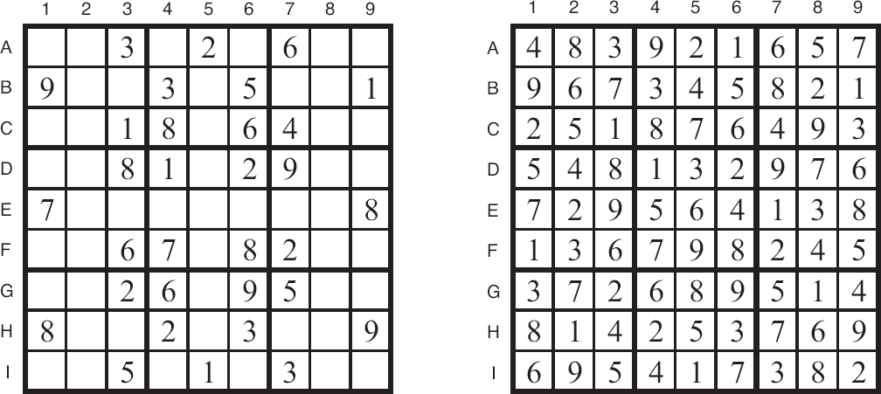
Sudoku
Digit placement puzzle on 9x9 grid with unique answer
Given an initial partially filled grid, fill remaining squares with a digit between 1 and 9
Each column, row, and nine 3×3 sub-grids must contain all nine digits
Some initial configurations are easy to solve and others very difficult

Slide 18
Sudoku Example
initial problem
a solution
How can we set this up as a CSP?

Slide 19
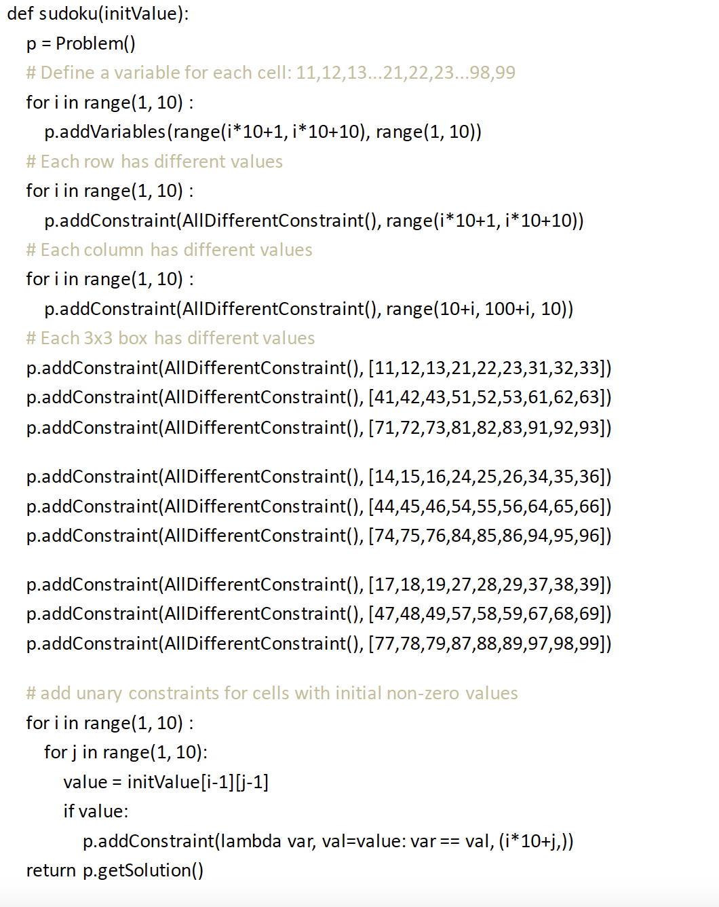
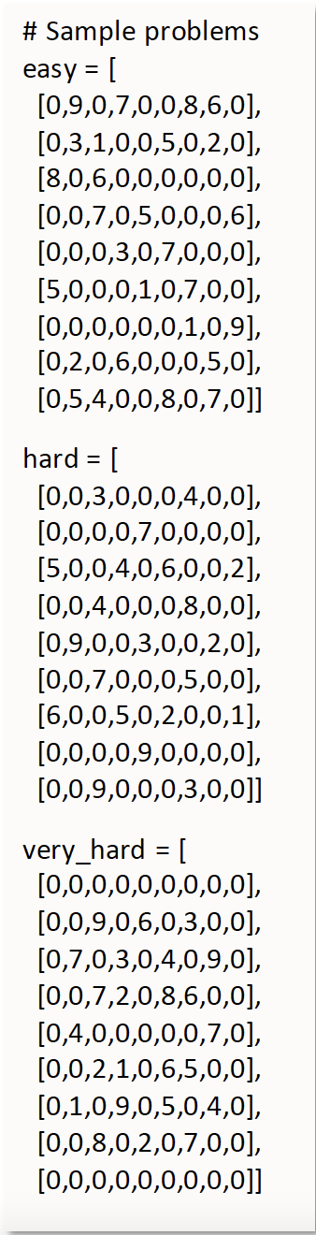

Slide 20
Local search for constraint problems
Basic idea:
  generate a random “solution”
  Use metric of “number of conflicts”
  Modifying solution by reassigning one variable at a time to decrease metric until solution found or no modification improves it
Has all features and problems of local search
like….?

Slide 21

Min Conflict Example
States: 4 Queens, 1 per column
Operators: Move a queen in its column
Goal test: No attacks
Evaluation metric: Total number of attacks (direct and indirect)
How many conflicts does each state have?

Slide 22
Basic Local Search Algorithm
Assign one domain value d_{i} to each variable v_{i}
While no solution & not stuck & not timed out:
  for each variable v_{i} where Cost(Value(v_{i})) > =0:
  bestCost ← ∞; bestList ← [ ];
  domain value d_{i} of v_{i}
  if Cost(d_{i}) < bestCost bestCost ← Cost(d_{i})
  bestList ← [d_{i}]
  else if Cost(d_{i}) = bestCost bestList ← bestList ∪ d_{i}
  Take a randomly selected move from bestList

Slide 23
Eight Queens using Backtracking
Note: in this example we put one queen in each row, not column

Slide 24
Eight Queens using Backtracking
Try Queen 1
Note: in this example we put one queen in each row, not column

Slide 25
Eight Queens using Backtracking
Try Queen 1
Try Queen 2
Note: in this example we put one queen in each row, not column

Slide 26
Eight Queens using Backtracking
Try Queen 1
Try Queen 2
Try Queen 3
Note: in this example we put one queen in each row, not column

Slide 27
Eight Queens using Backtracking
Try Queen 1
Try Queen 2
Try Queen 3
Try Queen 4
Note: in this example we put one queen in each row, not column

Slide 28
Eight Queens using Backtracking
Try Queen 1
Try Queen 2
Try Queen 3
Try Queen 4
Try Queen 5
Stuck!
Note: in this example we put one queen in each row, not column

Slide 29
Eight Queens using Backtracking
Try Queen 1
Try Queen 2
Try Queen 3
Try Queen 4
Try Queen 5
Stuck!
Undo move
for Queen 5
Note: in this example we put one queen in each row, not column

Slide 30
Eight Queens using Backtracking
Try next value
for Queen 5
Still Stuck
Try Queen 1
Try Queen 2
Try Queen 3
Try Queen 4
Try Queen 5
Stuck!
Undo move
for Queen 5
Note: in this example we put one queen in each row, not column

Slide 31
Eight Queens using Backtracking
Try next value
for Queen 5
Still Stuck
Undo move
for Queen 5
no move left
Try Queen 1
Try Queen 2
Try Queen 3
Try Queen 4
Try Queen 5
Stuck!
Undo move
for Queen 5
Note: in this example we put one queen in each row, not column

Slide 32
Eight Queens using Backtracking
Backtrack and
undo last move
for Queen 4
Try next value
for Queen 5
Still Stuck
Undo move
for Queen 5
no move left
Try Queen 1
Try Queen 2
Try Queen 3
Try Queen 4
Try Queen 5
Stuck!
Undo move
for Queen 5
Note: in this example we put one queen in each row, not column

Slide 33
Eight Queens using Backtracking
Backtrack and
undo last move
for Queen 4
Try next value
for Queen 5
Still Stuck
Undo move
for Queen 5
no move left
Try next value
for Queen 4
Try Queen 1
Try Queen 2
Try Queen 3
Try Queen 4
Try Queen 5
Stuck!
Undo move
for Queen 5
Note: in this example we put one queen in each row, not column

Slide 34
Eight Queens using Backtracking
Backtrack and
undo last move
for Queen 4
Try next value
for Queen 5
Still Stuck
Undo move
for Queen 5
no move left
Try next value
for Queen 4
Try Queen 1
Try Queen 5
Try Queen 2
Try Queen 3
Try Queen 4
Try Queen 5
Stuck!
Undo move
for Queen 5
Note: in this example we put one queen in each row, not column

Slide 35
Eight Queens using Backtracking
Backtrack and
undo last move
for Queen 4
Try next value
for Queen 5
Still Stuck
Undo move
for Queen 5
no move left
Try next value
for Queen 4
Try Queen 1
Try Queen 5
Try Queen 6
Try Queen 2
Try Queen 3
Try Queen 4
Try Queen 5
Stuck!
Undo move
for Queen 5
Note: in this example we put one queen in each row, not column

Slide 36
Eight Queens using Backtracking
Backtrack and
undo last move
for Queen 4
Try next value
for Queen 5
Still Stuck
Undo move
for Queen 5
no move left
Try next value
for Queen 4
Try Queen 1
Try Queen 5
Try Queen 6
Try Queen 2
Try Queen 3
Try Queen 4
Try Queen 5
Stuck!
Undo move
for Queen 5
Try Queen 7
Stuck Again
Note: in this example we put one queen in each row, not column

Slide 37
Eight Queens using Backtracking
Backtrack and
undo last move
for Queen 4
Try next value
for Queen 5
Still Stuck
Undo move
for Queen 5
no move left
Try next value
for Queen 4
Undo move
for Queen 7
and so on...
Try Queen 1
Try Queen 5
Try Queen 6
Try Queen 2
Try Queen 3
Try Queen 4
Try Queen 5
Stuck!
Undo move
for Queen 5
Try Queen 7
Stuck Again
Note: in this example we put one queen in each row, not column

Slide 38
Eight Queens using Local Search
Note: in this example we put one queen in each row, not column

Slide 39
Eight Queens using Local Search
Place 8 Queens
randomly on
the board
Note: in this example we put one queen in each row, not column

Slide 40
Eight Queens using Local Search
Place 8 Queens
randomly on
the board
Pick a Queen:
Calculate cost
of each move
3
1
4
1
5
1
0
1
Note: in this example we put one queen in each row, not column

Slide 41
Eight Queens using Local Search
Place 8 Queens
randomly on
the board
Take least cost
move then try
another Queen
Pick a Queen:
Calculate cost
of each move
3
1
4
1
5
1
0
1
0
1
4
1
4
1
4
1
Note: in this example we put one queen in each row, not column

Slide 42
Eight Queens using Local Search
Place 8 Queens
randomly on
the board
Take least cost
move then try
another Queen
Pick a Queen:
Calculate cost
of each move
3
1
4
1
5
1
0
1
1
4
1
3
1
1
4
1
3
0
1
4
1
4
1
4
1
Note: in this example we put one queen in each row, not column

Slide 43
Eight Queens using Local Search
Place 8 Queens
randomly on
the board
Take least cost
move then try
another Queen
3
1
3
Pick a Queen:
Calculate cost
of each move
2
1
3
1
2
1
3
1
4
1
5
1
0
1
1
4
1
3
1
1
4
1
3
0
1
4
1
4
1
4
1
Note: in this example we put one queen in each row, not column

Slide 44
Eight Queens using Local Search
Place 8 Queens
randomly on
the board
Take least cost
move then try
another Queen
3
1
3
Pick a Queen:
Calculate cost
of each move
2
1
3
1
2
1
3
1
4
1
5
1
0
1
1
4
1
3
1
1
4
1
3
0
1
4
1
4
1
4
1
1
3
1
4
1
4
1
3
2
Note: in this example we put one queen in each row, not column

Slide 45
Eight Queens using Local Search
Place 8 Queens
randomly on
the board
Take least cost
move then try
another Queen
3
1
3
Pick a Queen:
Calculate cost
of each move
2
1
3
1
2
1
3
1
4
1
5
1
0
1
1
4
1
3
1
1
4
1
3
0
1
4
1
4
1
4
1
1
3
1
4
1
4
1
3
2
2
2
2
2
3
2
2
4
1
Note: in this example we put one queen in each row, not column

Slide 46
Eight Queens using Local Search
Place 8 Queens
randomly on
the board
Take least cost
move then try
another Queen
3
1
3
Pick a Queen:
Calculate cost
of each move
2
1
3
1
2
1
2
3
1
1
2
1
3
2
3
3
1
4
1
5
1
0
1
1
4
1
3
1
1
4
1
3
0
1
4
1
4
1
4
1
1
3
1
4
1
4
1
3
2
2
2
2
2
3
2
2
4
1
Note: in this example we put one queen in each row, not column

Slide 47
Eight Queens using Local Search
Place 8 Queens
randomly on
the board
Take least cost
move then try
another Queen
3
2
1
1
3
2
0
1
2
3
4
1
2
2
2
1
3
Pick a Queen:
Calculate cost
of each move
1
2
3
1
1
2
1
3
2
3
3
1
4
1
5
1
0
1
1
4
1
3
1
1
4
1
3
0
1
4
1
4
1
4
1
1
3
1
4
1
4
1
3
2
2
2
2
2
3
2
2
4
1
Note: in this example we put one queen in each row, not column

Slide 48
Eight Queens using Local Search
Place 8 Queens
randomly on
the board
Take least cost
move then try
another Queen
3
2
1
1
3
2
0
1
2
3
4
1
2
2
2
1
3
Pick a Queen:
Calculate cost
of each move
1
2
3
1
1
2
1
3
2
3
3
1
4
1
5
1
0
1
1
4
1
3
1
1
4
1
3
0
1
4
1
4
1
4
1
1
2
3
2
1
1
4
3
1
3
1
4
2
1
2
3
2
3
2
2
2
2
3
2
2
4
1
Note: in this example we put one queen in each row, not column

Slide 49
Eight Queens using Local Search
Place 8 Queens
randomly on
the board
Take least cost
move then try
another Queen
3
2
2
1
1
1
3
2
0
3
1
1
2
2
3
4
3
1
2
2
2
2
2
1
3
1
Pick a Queen:
Calculate cost
of each move
2
2
3
1
1
2
1
3
2
3
3
1
4
1
5
1
0
1
1
4
1
3
1
1
4
1
3
0
1
4
1
4
1
4
1
1
2
3
2
1
1
4
3
1
3
1
4
2
1
2
3
2
3
2
2
2
2
3
2
2
4
1
Note: in this example we put one queen in each row, not column

Slide 50
Eight Queens using Local Search
Place 8 Queens
randomly on
the board
Take least cost
move then try
another Queen
3
2
2
1
1
1
3
2
0
3
1
1
2
2
3
4
3
1
2
2
2
2
2
1
3
1
Pick a Queen:
Calculate cost
of each move
2
2
3
1
1
2
1
3
2
3
3
1
4
1
5
1
0
1
1
4
1
3
1
1
4
1
3
0
1
4
1
4
1
4
1
1
2
3
2
1
1
4
3
1
3
1
4
2
1
2
3
2
3
2
2
2
2
2
3
2
2
3
2
2
2
1
4
3
1
3
1
Note: in this example we put one queen in each row, not column

Slide 51
Eight Queens using Local Search
Place 8 Queens
randomly on
the board
Take least cost
move then try
another Queen
3
2
2
1
1
1
3
2
0
3
1
1
2
2
3
4
3
1
2
2
2
2
2
1
3
1
Pick a Queen:
Calculate cost
of each move
2
2
3
1
1
2
1
3
2
3
3
1
4
1
5
1
0
1
1
4
1
3
1
1
4
1
3
0
1
4
1
4
1
4
1
1
2
3
2
1
1
4
3
1
3
1
4
2
1
2
3
2
3
2
2
2
2
2
3
2
2
3
2
2
2
1
4
3
1
3
1
2
2
1
2
3
3
1
2
1
Note: in this example we put one queen in each row, not column

Slide 52
Eight Queens using Local Search
Place 8 Queens
randomly on
the board
Take least cost
move then try
another Queen
3
2
2
1
1
1
3
2
0
3
1
1
2
2
3
4
3
1
2
2
2
2
2
1
3
1
Pick a Queen:
Calculate cost
of each move
2
2
3
1
1
2
1
3
2
3
3
1
4
1
5
1
0
1
1
4
1
3
1
1
4
1
3
0
1
4
1
4
1
4
1
1
2
3
3
2
3
1
1
3
1
4
3
2
1
3
1
3
4
2
2
1
2
3
3
2
3
0
2
2
2
2
2
3
2
2
3
2
2
2
1
4
3
1
3
1
2
2
1
2
3
3
1
2
1
Note: in this example we put one queen in each row, not column

Slide 53
Eight Queens using Local Search
Place 8 Queens
randomly on
the board
Take least cost
move then try
another Queen
Answer Found
3
2
2
1
1
1
3
2
0
3
1
1
2
2
3
4
3
1
2
2
2
2
2
1
3
1
Pick a Queen:
Calculate cost
of each move
2
2
3
1
1
2
1
3
2
3
3
1
4
1
5
1
0
1
1
4
1
3
1
1
4
1
3
0
1
4
1
4
1
4
1
1
2
3
3
2
3
1
1
3
1
4
3
2
1
3
1
3
4
2
2
1
2
3
3
2
3
0
2
2
2
2
2
3
2
2
3
2
2
2
1
4
3
1
3
1
2
2
1
2
3
3
1
2
1
Note: in this example we put one queen in each row, not column

Slide 54
Backtracking Performance
5000
4000
3000
Time in seconds
2000
1000
0
0
4
8
12
16
20
24
28
32
Number of Queens

Slide 55
Local Search Performance
2500
2000
1500
Time in seconds
1000
500
0
0
5000
10000
15000
20000
Number of Queens

Slide 56
Min Conflict Performance
Performance depends on quality and informativeness of initial assignment; inversely related to distance to solution
Min Conflict often has astounding performance
Can solve arbitrary size (i.e., millions) N-Queens problems in constant time
Appears to hold for arbitrary CSPs with the caveat…

Slide 57
Challenges for constraint reasoning
What if not all constraints can be satisfied?
  Hard vs. soft constraints vs. preferences
  Degree of constraint satisfaction
  Cost of violating constraints
What if constraints are of different forms?
  Symbolic constraints
  Logical constraints
  Numerical constraints [constraint solving]
  Temporal constraints
  Mixed constraints

Slide 58
Summary
Many problems can be effectively modeled as constraints solving problems
The approach is very good at reducing the amount of search needed
Arc consistency is simple yet powerful
Constraints are also useful for local search
There’s a lot of complexity in many real-world problems that require additional ideas and tools

